Slide 1

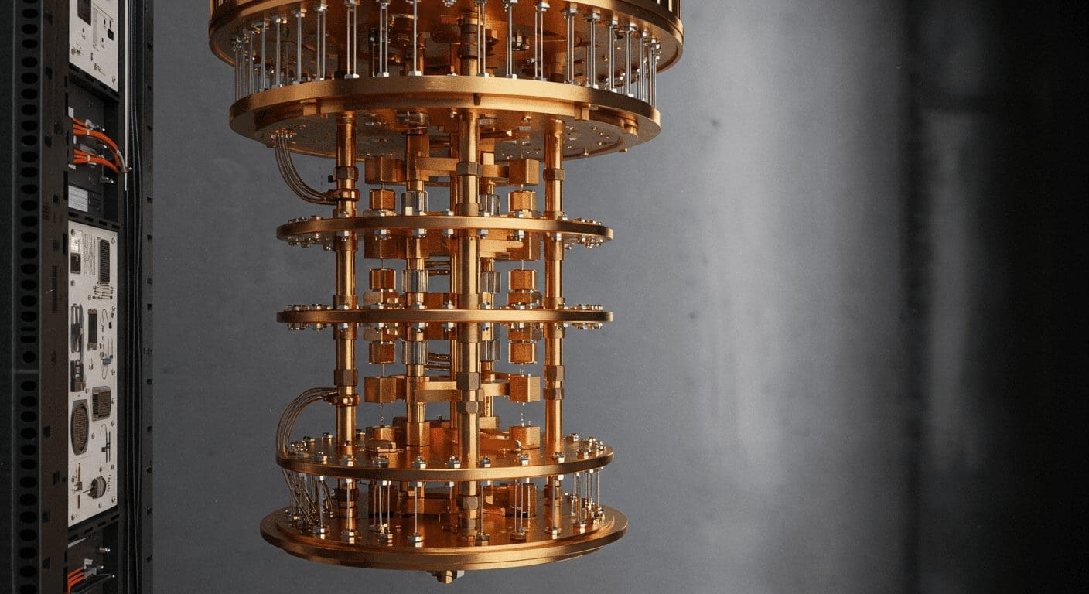

IT501
Content
Page 01
Presentation
Quantum
Computing
Systems Integration and Architecture
Presented by
Puno, Karl Vincent D.
Satsatin, Ma. Allison L.

Slide 2
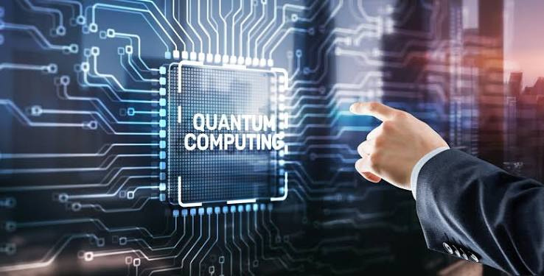
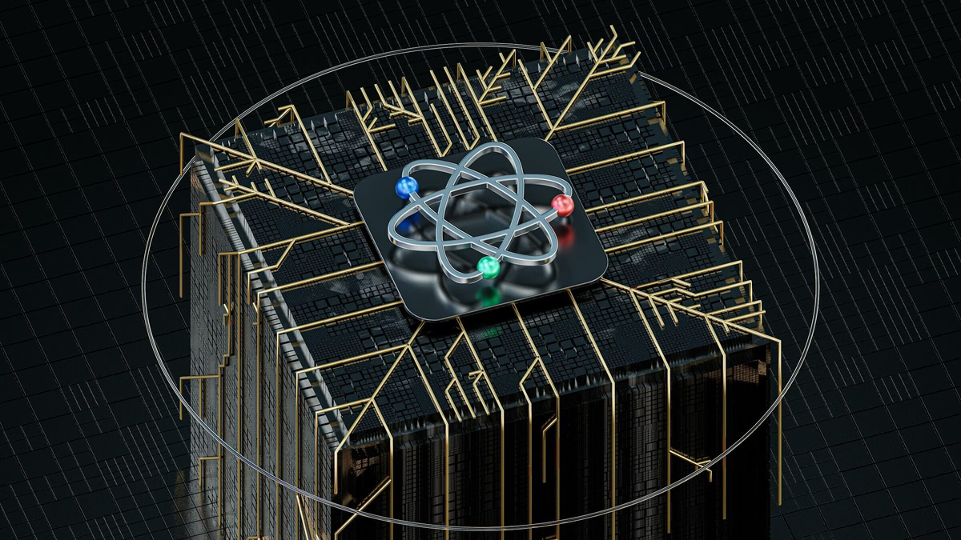
Home
Content
Contact Us
Page 02
Presentation
What is Quantum
Computing?
Quantum computing is an emerging computing paradigm built on the quantum mechanics of atomic particles, instead of transistors, it uses particles like electrons and protons to process information.
Classical computers store data as a bit — a 0 or a 1. Quantum computers use a qubit, which can hold 0, 1, and a superposition of both at once.
Content Page
Next Page

Slide 3



Home
Content
Contact Us
Page 03
Presentation
Quantum States
INTERFERENCE
ENTANGLEMENT
SUPERPOSITION
Waves of probability combine, amplifying correct answers and cancelling out wrong ones during computation.
Two particles become linked so strongly that the state of one instantly relates to the state of the other, at any distance.
A qubit exists as a linear combination of 0 and 1 simultaneously, not one or the other, but both at once.
Content Page
Next Page

Slide 4
Home
Content
Contact Us
Page 4
Presentation
Classical Bit vs. Qubit
Classical Bit
Qubit
LINEAR
growth
Add one transistor → capacity increases by one unit. One state (0 or 1) processed at a time.
2n
exponential growth per qubit
Add one qubit → processing capacity doubles. Multiple states processed simultaneously via superposition.
Content Page
Next Page

Slide 5
Home
Content
Contact Us
Page 05
Presentation
Exponential Growth of Qubit Power
1 qubit
2 qubit
3 qubit
4 qubit
n qubit
~ 1 relative states
~ 2 relative states
~ 4 relative states
~ 8 relative states
2ⁿ relationship
Qubit power grows as 2ⁿ, while added traditional transistors increase capacity linearly.
Content Page
Next Page

Slide 6

Home
Content
Contact Us
Page 06
Presentation
Salient Features of Quantum Computing
Quantum Information Science
Many Computing Models
Unstable Qubit States
Circuit, cellular automata, Turing machine, one-way, and adiabatic models.
Maintaining qubit states is difficult and highly sensitive.
A subfield of quantum information science.
Exponential Capacity
Quantum Hardware
Low-level Particles
Adding qubits increases processing power exponentially.
Superconductors and superfluid are highlighted.
Computation uses atomic and subatomic behavior.
Content Page
Next Page

Slide 7
Home
Content
Contact Us
Page 07
Presentation
Quantum Computing Models
Five architectural approaches researchers use to realize quantum computation.
Quantum Circuit model
Quantum Cellular Automata
Quantum Turing Machine
One-Way Quantum Computer
Adiabatic Quantum Computer
Content Page
Next Page

Slide 8
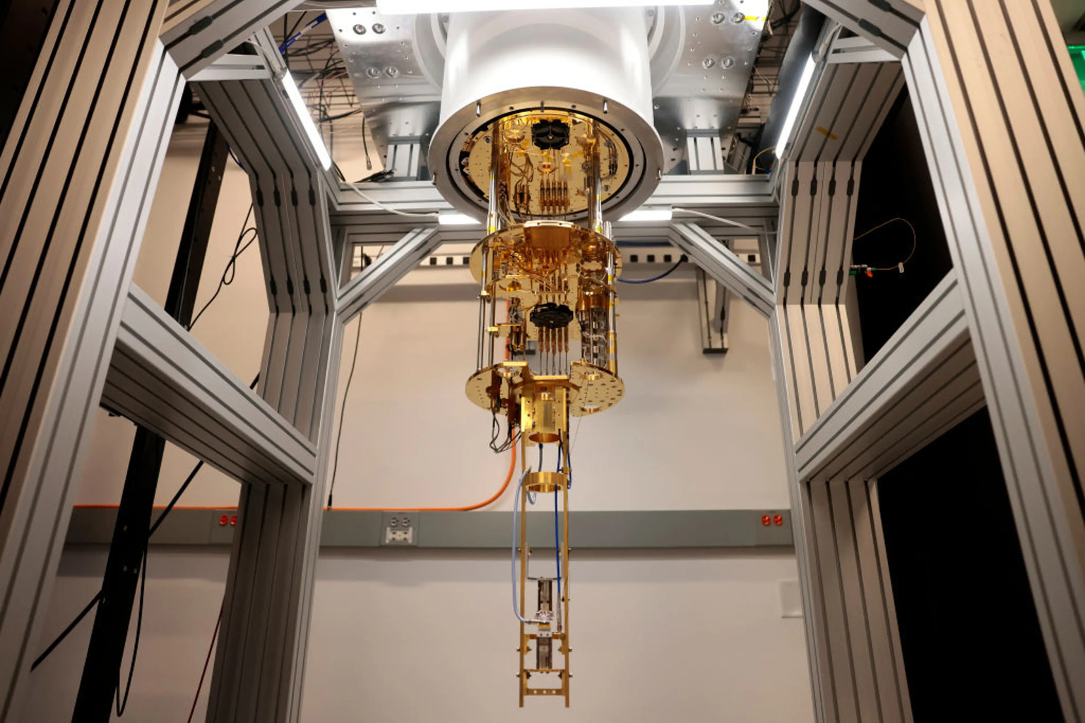

Home
Content
Contact Us
Page 08
Presentation
History of
Quantum Computing
1980
1994
2000
Feynman & Manin proposals
Shor’s factoring algorithm
7-qubit computer
1900–1925
1985
1998
2017
Quantum physics ideas
David Deutsch
First 2-qubit computer
IBM commercial-use announcement
Content Page
Next Page

Slide 9
Home
Content
Contact Us
Page 09
Presentation
1980s–1985: From Idea to Universal Quantum Computing
  The chapter traces domain-specific quantum-computing work to the 1980s.
  Richard Feynman and Yuri Manin proposed the development of quantum computers.
  In 1985, David Deutsch of Oxford worked on quantum logical gates for a universal quantum computer processor.
  The chapter identifies Deutsch as the father of modern quantum computing systems.
Content Page
Next Page

Slide 10
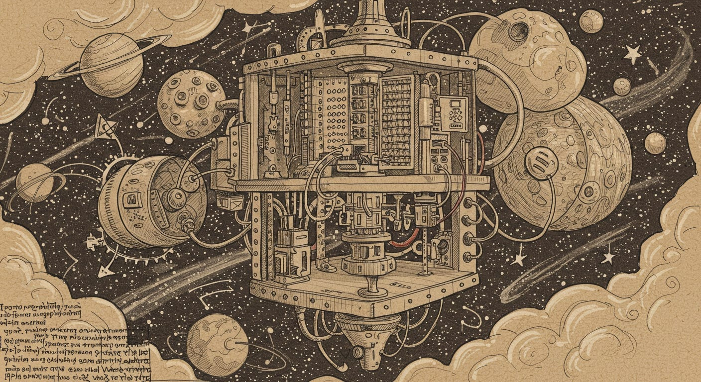



Home
Content
Contact Us
Page 10
Presentation
1994–2000: Algorithms and Early Qubits
1994
1998
2000
Peter Shor proposed an algorithm for factoring numbers.
Isaac Chuang, Neil Gershenfeld, and Mark Kubinec built the first 2-qubit computer.
Emanuel Knill, Raymond Laflamme, and Rudy Martinez developed a 7-qubit computer using trans-crotonic-acid.
Content Page
Our Website
Our Email Address
Our Address
Next Page

Slide 11
Home
Content
Contact Us
Page 11
Presentation
2017 and the Quantum Computing Industry
  In 2017, IBM announced a quantum computer intended for commercial use within its network and with selected partners.
  Major companies involved in quantum-computing research and development include IBM, Google, Microsoft, Alibaba, D-Wave Systems, Intel, Nokia, and HP.
  These developments highlight the growing interest and investment in quantum-computing technology.
  Historical projections mentioned here reflect expectations at the time and should be viewed as historical context rather than current forecasts.
Content Page
Next Page

Slide 12
Home
Content
Contact Us
Page 12
Presentation
What is Quantum Physics?
Examples include:
  electrons
  protons
  neutrons
  photons
  waves
  Quantum physics deals with very small particles and units of matter and energy.
  It examines how small particles behave under energy, electromagnetic effects, and other forces.
  Understanding particle states helps support the development of quantum logical gates and quantum computing systems.
Content Page
Next Page

Slide 13
Home
Content
Contact Us
Page 13
Presentation
Theory of Quantum Computing
Classical Approach
Quantum Approach
Traditional digital machines use binary logic: voltage/current present = 1; absent = 0. More transistors are added to increase capacity.
Quantum mechanics allows additional states through interference, superposition, and entanglement, supporting exponential growth in processing capacity.
Content Page
Next Page

Slide 14
Home
Content
Contact Us
Page 14
Presentation
Working Principle of Quantum Computing
  Particle can exist under multiple conditions at the same time.
  Influences mentioned include electromagnetic waves, temperature, flipping, rotations, and other physical processes.
  Superposition combines states so that numerous states can be represented simultaneously.
  Adding more qubits increases the number of possible states exponentially.
Content Page
Next Page

Slide 15
Home
Content
Contact Us
Page 15
Presentation
Binary States
Quantum Particles
A particle can hold multiple states simultaneously under the influence of triggers such as electromagnetic waves, temperature, flipping, and rotation.
Numerous states are achieved at the same time and space, using superposition to combine two states into another.
Only four possible combinations exist, processed one at a time:
00
01
10
11
Content Page
Next Page

Slide 16
Home
Content
Contact Us
Page 16
Presentation
How Many States Can Quantum Computing Handle?
TODAY'S PROCESSORS
THEORETICAL LIMIT
27
states handled simultaneously by present-day quantum processors
UNLIMITED
In theory, the number of states supported in quantum computing is infinite unlike classical systems, which process one state at a time.
Content Page
Next Page

Slide 17
Home
Content
Contact Us
Page 17
Presentation
Superimposition / Superposition
  Describes it as the combination of two distinct quantum states.
  The resulting state is a linear combination of those states.
  This lets a qubit represent a richer state than a classical bit’s single 0-or-1 condition.
  Superposition is one of the central ideas used to explain quantum speedups.
Content Page
Next Page

Slide 18
Home
Content
Contact Us
Page 18
Presentation
Entanglement
Linked quantum particles
PARTICLE A
PARTICLE B
A quantum particle can be related to another particle through a shared quantum state.
Linking two quantum particles even when they are separated in space.
Content Page
Next Page

Slide 19
Home
Content
Contact Us
Page 19
Presentation
Traditional vs. Quantum Computing
PROCESSING MATERIAL
DATA UNIT
STATES
SCALING
Traditional: semiconductors and transistors
Quantum: atomic and subatomic particles
Traditional: bits
Quantum: qubits
Traditional: one state at a time
Quantum: multiple states
Traditional: linear
Quantum: exponential
Content Page
Next Page

Slide 20
Home
Content
Contact Us
Page 20
Presentation
Traditional vs. Quantum: Suitability and Cost
Not every task needs quantum computing
Traditional Computing
Quantum Computing
Mature technology with broad software support and wide everyday use.
Presented as especially relevant to factorization, data analysis, machine learning, AI, and simulation; everyday applications may not be as suitable.
Content Page
Next Page

Slide 21
Home
Content
Contact Us
Page 21
Presentation
Environment and Error Rate
Why quantum hardware needs special conditions
ENVIRONMENT
ERROR RATE
Traditional computers can operate in normal environments. Quantum computers require highly cool environments and specialized cooling approaches.
Quantum systems have higher error rates because they are strongly affected by external sources and physical interference.
Content Page
Next Page

Slide 22
Home
Content
Contact Us
Page 22
Presentation
Operations and State Behavior
  Traditional computing uses linear algebra while quantum computing uses Boolean algebra for operations.
  Classical computing states are discrete while quantum-computing states are continuous.
  These statements are reproduced here as they appear in the source chapter.
Content Page
Next Page
Content Page

Slide 23
Home
Content
Contact Us
Page 23
Presentation
Real-World
Quantum Applications
Healthcare
Cybersecurity
Artificial intelligence
Breaking or testing encryption and simulating security techniques
Big data, machine learning, analytics, recognition
Drug simulation, diagnosis, and treatment
Finance
Complex manufacturing
Telecommunication
Banking, Forex, trading, real-time processing
Defense, radar, satellite, meteorology, telemetry
Large combinatorial and interrelated processes
Content Page
Next Page

Slide 24
Home
Content
Contact Us
Page 24
Presentation
Healthcare Applications
  Drug development can involve simulating the behavior of many molecules and comparing complex processes.
  Quantum computing could help with simulation and comparison in drug manufacturing.
  It may support diagnosis by examining multidimensional attributes of the body at atomic and molecular levels.
  It may also be useful in treatments, especially radiology and similar techniques.
Content Page
Next Page

Slide 25
Home
Content
Contact Us
Page 25
Presentation
Cybersecurity Applications
Threat and defense perspectives
SECURITY RISK
SECURITY DEFENSE
High-power quantum computing could decode complex ciphering and encryption methodologies, creating risks for communication security.
Quantum computing can also be used to simulate security techniques, explore combinatorial patterns, and identify network security issues.
Content Page
Next Page

Slide 26
Home
Content
Contact Us
Page 26
Presentation
Artificial Intelligence Applications
Quantum processing and data-heavy AI work
  Highly demanding in processing power because of big-data analytics and pattern understanding.
  Quantum computing is presented as a possible way to supply additional processing power.
  Potential areas mentioned include more efficient machine learning, real-time data analytics, automated actions, object recognition, and movement recognition.
Content Page
Next Page

Slide 27
Home
Content
Contact Us
Page 27
Presentation
Financial Applications
BANKING
FOREX
TRADING
Financial systems require large amounts of computation for real-time decisions.
Foreign-exchange markets operate globally and depend on fast processing.
Quantum power is presented as useful for processing-heavy, low-latency trading tasks.
Content Page
Next Page

Slide 28
Home
Content
Contact Us
Page 28
Presentation
Complex
Manufacturing
Large combinations of interrelated processes
  Manufacturing can involve thousands of interrelated processes and components.
  Such combinatorial calculations can demand high processing capacity.
  The chapter suggests quantum computing could make these processes more useful, reliable, accurate, and efficient.
Content Page
Next Page

Slide 29
Home
Content
Contact Us
Page 29
Presentation
Telecommunication Applications
Processing complex signals and large data sets
  Defense, security, research and development, telemetry, meteorology, radar communication, and satellite communication.
  These areas often require high-level and fast processing for complex algorithms.
  Quantum computing is presented as a possible source of the processing power needed for complex, real-time data and signal work.
Content Page
Next Page

Slide 30
Home
Content
Contact Us
Page 30
Presentation
Other Possible Applications
Logistics and supply chain
Digital marketing
Software development
Defense and national security
Military research and development
Content Page
Next Page

Slide 31
Home
Content
Contact Us
Page 31
Presentation
Why Major Quantum Projects Matter
  The chapter describes quantum computing as a pathfinder technology because of its high processing capacity.
  Modern communication systems and IT applications have greatly increased the volume of data that must be processed.
  Traditional systems are described as struggling with growing processing demands.
  Large technology companies therefore started major quantum-computing projects.
Content Page
Next Page

Slide 32
Home
Content
Contact Us
Page 32
Presentation
IBM Quantum Project
  IBM is described as a pioneer in quantum-computing adaptation.
  IBM tested quantum computing in a cloud environment in 2016 and 2017.
  The chapter highlights Circuit and Qiskit development and identifies Falcon 27 qubits as the starting point of a 2020 roadmap.
  The book describes targets and projections for much larger processors and continued cloud-based development.
Content Page
Next Page

Slide 33
Home
Content
Contact Us
Page 33
Presentation
IBM: Tools and Development
QISKIT
QISKIT RUNTIME
CLOUD & SERVERLESS
A leading platform highlighted for quantum developers.
A development/runtime environment identified as a major platform.
The chapter describes quantum applications and cloud software, including a quantum serverless platform.
Content Page
Next Page

Slide 34
Home
Content
Contact Us
Page 34
Presentation
Honeywell Quantum Project
Defense
  Honeywell is described as a leader using charged atoms (ions) to hold quantum data.
  Lasers, microwave signals, and electromagnetic fields are used to hold and manipulate charges on ions.
  Electromagnetic traps are used for holding ions.
  Two projects are highlighted: Honeywell Quantum Solutions (HQS) and Cambridge Quantum Computing (CQC).
  The chapter says the two were merged to provide broader quantum-computing solutions for demanding industries.
Aerospace
Cybersecurity
target industries
Complex manufacturing
Finance
Pharmaceuticals
Content Page
Next Page

Slide 35
Home
Content
Contact Us
Page 35
Presentation
Google Quantum Project
  Developed effort toward advanced quantum systems.
  Google announced a Noisy Intermediate Scale Quantum (NISQ) platform and used it to simulate a chemical reaction.
  A Fermi–Hubbard model was simulated using 16 qubits.
  The company worked toward error-corrected quantum systems and developed the open-source Cirq library.
  The chapter also describes a 100-qubit system for further research.
Content Page
Next Page

Slide 36
Home
Content
Contact Us
Page 36
Presentation
Microsoft Azure Quantum
  Microsoft established Azure Quantum as a platform for hardware and software development.
  Its approach in the chapter centers on topological qubits and Majorana Zero Modes.
  Support for Q#, Cirq, Qiskit, and other development platforms and languages.
  Other areas include nanomaterials, quantum-mechanics equipment, open-source contribution, testing laboratories, and cloud access for partners.
Content Page
Next Page

Slide 37
Home
Content
Contact Us
Page 37
Presentation
Main Quantum-Computing Terminologies
Superconductors
Superfluid
Quantum mechanics
Very low resistance; divided into Type-I and Type-II.
Zero-viscosity fluid state used especially in cooling contexts.
Physics of atomic and subatomic behavior.
Qubit
Quantum logic gate
Josephson junction
Fundamental quantum data unit.
Reversible quantum circuit building unit.
Two superconductors separated by a non-superconducting barrier.
Content Page
Next Page

Slide 38
Home
Content
Contact Us
Page 38
Presentation
Superconductors
TYPE-I
TYPE-II
The chapter lists mercury, lead, zinc, aluminum, sulfur, and others. It gives a critical-temperature range of about 0.000325 to 7.8 K.
The chapter describes compounds of lead and copper, including HgBa₂Ca₂Cu₃O₈, and notes that electromagnetic fields can penetrate Type-II materials.
Content Page
Next Page

Slide 39
Home
Content
Contact Us
Page 39
Presentation
Superfluid
A special fluid state used in cooling
  A superfluid is described as flowing without losing kinetic energy because of zero viscosity.
  It can maintain motion without external energy and can creep along container walls.
  It may have very high thermal conductivity, making it useful in cooling sophisticated equipment, including quantum computing systems.
  Examples named include helium-3, helium-4, some Bose–Einstein condensates, lithium-6 atoms, atomic rubidium-85, and atomic sodium.
Content Page
Next Page

Slide 40
Home
Content
Contact Us
Page 40
Presentation
Superfluid: Characteristics and Uses
CHARACTERISTICS
THERMAL ROLE
USES
Can creep along container walls; motion is maintained; some examples are compressible while others are not.
High thermal conductivity makes superfluids useful in cooling high-performance equipment.
Cooling high magnetic fields, detecting exotic particles, and supporting quantum-computing systems.
Content Page
Next Page

Slide 41
Home
Content
Contact Us
Page 41
Presentation
Quantum Mechanics
The branch of physics behind the chapter
  Quantum mechanics studies the behavior of very small particles at atomic and subatomic levels.
  It examines movement, conditions, energy levels, and the effects of external energy sources.
  The chapter contrasts it with classical physics, which focuses on macroscopic physical behavior.
  Quantum behavior can appear strange because classical physical theories do not fully apply under certain conditions.
Content Page
Next Page

Slide 42
Home
Content
Contact Us
Page 42
Presentation
Quantum Mechanics: Main Characteristics
UNCERTAINTY & PROBABILITY
WAVE–PARTICLE DUALITY
SCIENTISTS
Max Planck, Albert Einstein, Ludwig Boltzmann, Niels Bohr, Werner Heisenberg, Erwin Schrödinger, and Max Born are named.
Heavily based on mathematical calculations governed by uncertainty and probability.
Quantum objects are presented with wave-particle duality, unlike the separated classical treatment.
Content Page
Next Page

Slide 43
Home
Content
Contact Us
Page 43
Presentation
Qubits in More Detail
THREE DESCRIPTIVE STATES
EXAMPLES
IMPLEMENTATIONS
  Photon polarization
  Electron spin
  Electron energy levels
  Angular rotation of a particle
  Trapped ions
  Atoms
  Molecules
  Photons
  Quasiparticles
0
1
Linear combination of 0 & 1
The source calls this linear combination superposition.
Content Page
Next Page

Slide 44
Home
Content
Contact Us
Page 44
Presentation
Quantum Logic Gates
Building blocks of a quantum circuit
  A quantum logic gate is described as the quantum analogue of a classical digital logic gate.
  It is a building unit of a quantum circuit used to process qubit information.
  The source emphasizes that quantum gates are reversible and are also called unitary operators.
  Examples listed include Pauli, Identity, controlled, phase shift, rotation, Hadamard, Swap, Toffoli, Fredkin, Ising coupling, Deutsch, and universal quantum gates.
Content Page
Next Page

Slide 45
Home
Content
Contact Us
Page 45
Presentation
Quantum Counting
Counting probable solutions
MEANING
CONNECTED IDEAS
The chapter describes quantum counting as the number of possible quantum solutions for a problem, also called efficiency counting.
It is related to search problems using Grover’s search algorithm, quantum phase estimation, and other quantum methods.
Content Page
Next Page

Slide 46
Home
Content
Contact Us
Page 46
Presentation
Grover’s Algorithm
COMPARISON
Quadratic improvement for unstructured search
CLASSICAL SEARCH
  Proposed by Indian-American engineer Lov Kumar Grover in 1996.
  Uses superposition and interference to improve search speed.
  If a classical search takes N steps, Grover’s search can find the value in about √N steps.
  It uses amplitude amplification to increase the probability of the desired solution.
  Unstructured data
  Approximately N checks in the chapter’s simplified comparison.
GROVER SEARCH
  Unstructured data
  Approximately √N steps in the chapter’s simplified comparison.
Content Page
Next Page

Slide 47
Home
Content
Contact Us
Page 47
Presentation
Shor’s Algorithm
2 MAIN PARTS
  Shor’s algorithm finds the prime factors of an integer.
  It was proposed by American mathematician Peter Shor in 1994.
  The chapter states a time complexity of O((log N)³) and O(log N) space for the factoring formulation it describes.
  The algorithm is presented as a major security concern because it can threaten encryption systems such as RSA and Diffie–Hellman.
CLASSICAL
Reduce the factoring problem to an order-finding problem.
QUANTUM
Use quantum computation to perform the order-finding step.
Content Page
Next Page

Slide 48
Home
Content
Contact Us
Page 48
Presentation
Josephson Junction
STRUCTURE
TUNNELING
SUPER CURRENT
Two superconducting materials separated by a non-superconducting material.
The chapter describes superconducting electrons tunneling through the barrier.
The current associated with this effect is called supercurrent and the structure is used in quantum systems.
Content Page
Next Page

Slide 49
Home
Content
Contact Us
Page 49
Presentation
Josephson Junction: Historical Note
  The junction is named after Brian David Josephson.
  Josephson predicted and demonstrated the effect of current through a non-superconducting tunnel between superconductors.
  He was awarded the Nobel Prize for this discovery.
Content Page
Next Page

Slide 50

Home
Content
Contact Us
Page 50
Presentation
Quantum Computing and Cybersecurity
THREAT
Quantum computing may weaken some existing encryption methods by making difficult mathematical problems easier to attack.
A central application and risk
DEFENSE
Quantum resources can also be used to simulate security techniques and test the resilience of systems.
WHY IT MATTERS
The chapter links quantum processing with complex combinatorial calculations and communication security.
Content Page
Next Page

Slide 51
Home
Content
Contact Us
Page 51
Presentation
Challenges & Outlook
Challenges
Outlook
•Qubit states are highly unstable and prone to interference
•Requires ultra-cold, isolated environments to maintain stability
•Error rates are far higher than classical systems
•Technology is costly and not yet mature for public use
•IBM targets 4,000+ qubit systems and 10K+ qubits by 2026
•Google is working toward a 1,000,000-qubit system by 2029
•Microsoft & Honeywell are advancing new qubit architectures
•Growth will unlock breakthroughs across medicine, AI, and security
Content Page
Next Page

Slide 52
Home
Content
Contact Us
Last Page
Presentation
Thank You For Your Attention
Closing Page

